Slide 1
Why Does My Computer Do That? Intro to Coding with Python– Conditionals
Dr. Ab Mosca (they/them)
Slides based off slides courtesy of Jordan Crouser (https://jcrouser.github.io/)

Slide 2
Plan for Today
Recap exercise from last class
Intro to conditionals

Slide 3
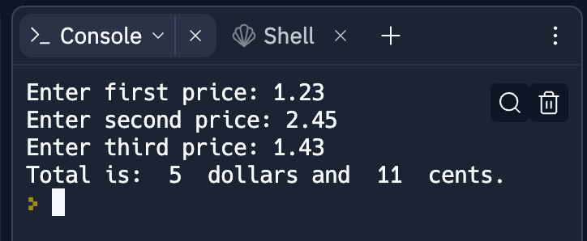
15-minute exercise: dollars and cents
Use built-in functions and functions from the math module to take 3 prices, calculate their sum, and output their total formatted like this:

Slide 4
RECAP
How is information represented
using electricity?

Slide 5
RECAP
How is information represented
using electricity?

Slide 6
One wire: a “bit”
“off”
“on”
Notes:
Let’s simplify things way down. Imagine our computer has just a single wire in it. If we’re going to try to represent information by running electricity through this wire, we’ve got two possible states: off and on. That’s not a whole lot to work with, but it’s enough to represent False and True, 0 and 1, No and Yes… or any other pair of values. Because we can represent exactly two things, this is called a “binary” system. The on/off state of a single wire is called a ”bit”, and it’s the smallest piece of information a computer can store.

Slide 7
Bits and booleans
Bits: 0 and 1
Boolean values: True and False
Boolean switches: imagine a world where every decision has a binary choice:
Go out or stay in?
Walk or take the car?
Cats or Dogs?
George Boole
1815 - 1864

Slide 8
So far: linear programs

Slide 9
What if we need to make a choice?

Slide 10
Booleans to the rescue!

Slide 11
Booleans to the rescue!

Slide 12
Just one problem: how do we write it?

Slide 13
We can only type one line at a time...

Slide 14
What we want to say

Slide 15
What we have to work with

Slide 16
Real life examples (pseudocode)
if (today is a weekday):
go to class
else: # (today is a weekend)
sleep in

Slide 17
Real life examples (pseudocode)
if (today is a weekday):
go to class
else: # (today is a weekend)
sleep in
if (food at dining hall looks good):
eat at dining hall
else: # food at dining hall doesn’t look good
order Domino’s

Slide 18
Real life example (change machine)
How many 20s to get to total amount of dollars?
Ex. User inputs $71
Output should be 3 $20-bills
Ex. User inputs $21
Output should be 1 $20-bill
Ex. User inputs $5
Output should be 0 $20-bills
print the ”s”
only if necessary
print the ”s”
only if necessary
print the ”s”
only if necessary

Slide 19
Real life example (change machine)
How many 20s to get to total amount of dollars?
Ex. User inputs $71
Output should be 3 $20-bills
Ex. User inputs $21
Output should be 1 $20-bill
Ex. User inputs $5
Output should be 0 $20-bills
print the ”s”
only if necessary
print the ”s”
only if necessary
print the ”s”
only if necessary
What is the if-else statement for this in pseudo code?

Slide 20
Real life example (change machine)
How many 20s to get to total amount of dollars?
Ex. User inputs $71
Output should be 3 $20-bills
Ex. User inputs $21
Output should be 1 $20-bill
Ex. User inputs $5
Output should be 0 $20-bills
print the ”s”
only if necessary
print the ”s”
only if necessary
print the ”s”
only if necessary
if (only one 20):
output message has no s
else: #multiple or no 20s’
output message has s

Slide 21
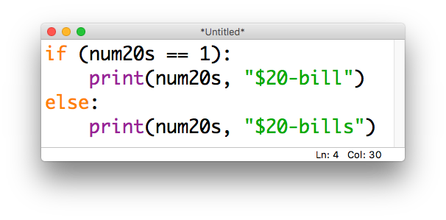
Real life example (change machine)

Slide 22
Relational operators
Operator | Meaning
== | equal to
!= | not equal to
< | less than
<= | less than or equal to
> | greater than
>= | greater than or equal to
these come in handy when constructing
boolean statements

Slide 23
Demo – Open a repl to follow along
Operator | Meaning
== | equal to
!= | not equal to
< | less than
<= | less than or equal to
> | greater than
>= | greater than or equal to
Notes:
Let’s say a good month is a month were more than half of the days are sunny
ask the user for number of sunny days and print the result
Let’s say I picked a number between 1 and 10 and you win if you guess any number except the number I picked

Slide 24
Multiple conditions
if (it is sunny):
go to the beach
if (it is snowy):
go skiing
else:
stay home

Slide 25
Sequential if statements are independent
if (it is sunny):
go to the beach
if (it is snowy):
go skiing
else:
stay home

Slide 26
Sequential if statements are independent
if (it is sunny):
go to the beach
if (it is snowy):
go skiing
else:
stay home
this line will always run

Slide 27
Sequential if statements are independent
if (it is sunny):
go to the beach
if (it is snowy):
go skiing
else:
stay home
this line will always run
this block will only run if it is sunny

Slide 28
Sequential if statements are independent
if (it is sunny):
go to the beach
if (it is snowy):
go skiing
else:
stay home
this line will always run
this block will only run if it is sunny
this line will always run
this block will only run if it is snowy

Slide 29
The else refers only to the nearest if
if (it is sunny):
go to the beach
if (it is snowy):
go skiing
else:
stay home
this line will always run
this block will only run if it is sunny
this line will always run
this block will only run if it is snowy
this block will only run if it is not snowy

Slide 30
To chain multiple “checks” together: elif
if (it is sunny):
go to the beach
elif (it is snowy):
go skiing
else: # it is neither sunny nor snowy
stay home
evaluated in order

Slide 31
this line will always run
if (it is sunny):
go to the beach
elif (it is snowy):
go skiing
else: # it is neither sunny nor snowy
stay home
this block will only run if it is sunny
To chain multiple “checks” together: elif
this line will only run if it is not sunny
evaluated in order
this block will only run if it is snowy
this block will only run if it is neither sunny nor snowy

Slide 32
Remember: order matters!
if (it is sunny): # regardless of snow
go to the beach
elif (it is snowy): # but not sunny
go skiing
else: # it is neither sunny nor snowy
stay home
evaluated in order

Slide 33
if (it is snowy): # regardless of sun
go skiing
elif (it is sunny): # but not snowy
go to the beach
else: # it is neither sunny nor snowy
stay home
Remember: order matters!
evaluated in order

Slide 34
Nested conditions
if (class is cancelled):
if (you have homework):
work on homework
else: # class cancelled, no HW binge-watch Netflix

Slide 35
Simultaneous conditions
if (it’s Friday and it’s 4pm):
go to tea
if (you’re hungry or you’re bored):
go to the CC

Slide 36
Work with someone near you to
write a (tiny!) program that uses chained conditionals
if-elif-else
write a (tiny!) program that uses a nested conditional
if
if-else
write a (tiny!) program that uses simultaneous conditions
if __ and __
if __ or __

